Slide 1

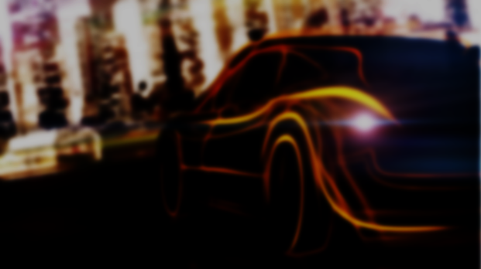
Car Performance Prediction
Using
IBM Watson
Machine Learning

Slide 2
1. MOHIT SONI 19BCE10038 VIT BHOPAL
2. SAARTH SRIVASTAVA 19BCE10074 VIT BHOPAL
3. ADARSH BHASKER SRIVASTAVA 19BCE10060 VIT BHOPAL
4. ARIKESHI SRIVASTAVA 19BCE10038 VIT BHOPAL

Slide 3

INTRODUCTION IBM WATSON MACHINE LEARNING
Deploy any models including machine learning and deep learning models and decision optimization models.
IBM Watson Machine Learning helps data scientists and developers to accelerate AI and machine learning deployment on IBM Cloud Pak for Data. Deploy AI models at scale across any cloud on an open, extensible architecture.
With IBM you can:
Dynamically retrain models with continuous learning.
Automatically generate APIs to build AI-powered applications through DevOps.
Manage and monitor models for model drift, bias and risk.
Bring any projects into production, including open source, third-party and IBM tools.

Slide 4

PROBLEM STATEMENT
Predicting the performance level of cars is an important and interesting problem. The main goal is to predict the performance of the car to improve the certain behavior of the vehicle. This can significantly help to improve the system's fuel consumption and increase efficiency.
The performance analysis of the car is based on the engine type, no of engine cylinders, fuel type, and horsepower, etc. These are the factors on which the health of the car can be predicted. It is an on-going process of obtaining, researching, analyzing, and recording the health based on the above three factors. The performance objectives like mileage, dependability, flexibility, and cost can be grouped together to play a vital role in the prediction of engine and engine management system. This approach is a very important step towards understanding the vehicle's performance.

Slide 5




SOFTWARES AND LANGUAGES USED
PyCharm
JUPYTER
App Building
Model Building
HTML AND CSS
PYTHON
Web Page Development
Flask App
Development

Slide 6

Work
Implementation

Slide 7
CONCLUSION
Regression Model helps in obtaining the output which involves in creating a clear relationship between the dependent and independent variable. Since the mileage of the car depends on the factors like weight, displacement, horsepower etc which are independent of each other, regression model acts as a better ML algorithm. RNN can not be used because the mileage of one car doesn't depends on the mileage of the other car.
This is a regression kind of problem since mileage has been predicted based on other numerical parameters. This model has been trained using random forest classifier and when data was tested for this model it gave an accuracy of around 88%.The prediction of mileage gives a better understanding of performance and usage of the car.

Slide 8
FUTURE SCOPE
Although, this system has achieved astonishing performance in car performance prediction problem our aim for the future research is to test this system to work successfully with various data sets with high number of input values to gain more appropriate results.

Slide 9
Thank You.

